Slide 1
Bayesian Knowledge Tracing and Discovery with Models
Ryan Shaun Joazeiro de Baker

Slide 2
Bayesian Knowledge Tracing
The classic method for assessing student knowledge within learning software
Classic articulation of this method (Corbett & Anderson, 1995)
Inspired by work by Atkinson in the 1970s

Slide 3
Bayesian Knowledge Tracing
For those who care, it is a 2 state hidden markov model

Slide 4
Bayesian Knowledge Tracing
For those who care, it is a 2 state hidden markov model
For everyone else, nyardely nyardley nyoo

Slide 5
Bayesian Knowledge Tracing
Reigned undisputed until about 2007
Now a vigorous battle is ongoing to determine the best replacement/extension
BKT with Dirichlet Priors (Beck & Chang, 2007)
Fuzzy BKT (Yudelson et al, 2008)
BKT with Contextual-Guess-and-Slip (Baker et al, 2008)
BKT with Help-Transition Differentiation (Beck et al, 2008)
Clustered-skills BKT (Ritter et al, 2009)
Performance Factors Analysis (Pavlik et al, 2009)

Slide 6
Still worth discussing
All of the main contenders except Pavlik et al’s approach are direct extensions or modifications of Corbett & Anderson (1995)

Slide 7
Bayesian Knowledge Tracing
Goal: For each knowledge component (KC), infer the student’s knowledge state from performance.
Suppose a student has six opportunities to apply a KC and makes the following sequence of correct (1) and incorrect (0) responses. Has the student has learned the rule?
0 0 1 0 1 1

Slide 8
Model Learning Assumptions
Two-state learning model
Each skill is either learned or unlearned
In problem-solving, the student can learn a skill at each opportunity to apply the skill
A student does not forget a skill, once he or she knows it
Only one skill per action

Slide 9
Model Performance Assumptions
If the student knows a skill, there is still some chance the student will slip and make a mistake.
If the student does not know a skill, there is still some chance the student will guess correctly.

Slide 10
Corbett and Anderson’s Model
Not learned
p(T)
Learned
p(L₀)
p(G)
1-p(S)
correct
correct
Two Learning Parameters
p(L₀) Probability the skill is already known before the first opportunity to use the skill in problem solving.
p(T) Probability the skill will be learned at each opportunity to use the skill.
Two Performance Parameters
p(G) Probability the student will guess correctly if the skill is not known.
p(S) Probability the student will slip (make a mistake) if the skill is known.

Slide 11
Bayesian Knowledge Tracing
Whenever the student has an opportunity to use a skill, the probability that the student knows the skill is updated using formulas derived from Bayes’ Theorem.

Slide 12


Formulas

Slide 13
Knowledge Tracing
How do we know if a knowledge tracing model is any good?
Our primary goal is to predict knowledge

Slide 14
Knowledge Tracing
How do we know if a knowledge tracing model is any good?
Our primary goal is to predict knowledge
But knowledge is a latent trait

Slide 15
Knowledge Tracing
How do we know if a knowledge tracing model is any good?
Our primary goal is to predict knowledge
But knowledge is a latent trait
But we can check those knowledge predictions by checking how well the model predicts performance

Slide 16
Fitting a Knowledge-Tracing Model
In principle, any set of four parameters can be used by knowledge-tracing
But parameters that predict student performance better are preferred

Slide 17
Knowledge Tracing
So, we pick the knowledge tracing parameters that best predict performance
Defined as whether a student’s action will be correct or wrong at a given time
Effectively a classifier/prediction model
We’ll discuss these more generally during the next lecture in the EDM track

Slide 18
One Recent Extension
Recently, there has been work towards contextualizing the guess and slip parameters (Baker, Corbett, & Aleven, 2008a, 2008b)
Do we really think the chance that an incorrect response was a slip is equal when
Student has never gotten action right; spends 78 seconds thinking; answers; gets it wrong
Student has gotten action right 3 times in a row; spends 1.2 seconds thinking; answers; gets it wrong

Slide 19
One Recent Extension
In this work, P(G) and P(S) are determined by a model that looks at time, previous history, the type of action, etc.
Significantly improves predictive power of method
Probability of distinguishing right from wrong increases from around 66% to around 71%

Slide 20
Other Recent Extensions
Many skills per parameter set (Ritter et al, 2009)
Improves predictive power for skills where we don’t have much data

Slide 21
Uses
Within educational data mining, there are several things you can do with these models
Outside of EDM, can be used to drive tutorial decisions

Slide 22
Uses of Knowledge Tracing
Often key components in models of other constructs
Help-Seeking and Metacognition (Aleven et al, 2004, 2008)
Gaming the System (Baker et al, 2004, 2008)
Off-Task Behavior (Baker, 2007)

Slide 23
Uses of Knowledge Tracing
If you want to understand a student’s strategic/meta-cognitive choices, it is helpful to know whether the student knew the skill
Gaming the system means something different if a student already knows the step, versus if the student doesn’t know it
A student who doesn’t know a skill should ask for help; a student who does, shouldn’t

Slide 24
Uses of Knowledge Tracing
Can be interpreted to learn about skills
But – note – only if you have a way to trust the parameter values
In Bayesian KT’s original implementation, many parameter values can fit the same data (Beck & Chang, 2007)
In later variants (Beck & Chang, 2007; Baker, Corbett, & Aleven, 2008; Ritter et al, 2009) this is less of a problem (though you should still double-check for this)

Slide 25
Skills from the Algebra Tutor
skill | L0 | T
AddSubtractTypeinSkillIsolatepositiveIso | 0.01 | 0.01
ApplyExponentExpandExponentsevalradicalE | 0.333 | 0.497
CalculateEliminateParensTypeinSkillElimi | 0.979 | 0.001
CalculatenegativecoefficientTypeinSkillM | 0.953 | 0.001
Changingaxisbounds | 0.01 | 0.01
Changingaxisintervals | 0.01 | 0.01
ChooseGraphicala | 0.001 | 0.306
combineliketermssp | 0.943 | 0.001

Slide 26
Which skills could probably be removed from the tutor?
skill | L0 | T
AddSubtractTypeinSkillIsolatepositiveIso | 0.01 | 0.01
ApplyExponentExpandExponentsevalradicalE | 0.333 | 0.497
CalculateEliminateParensTypeinSkillElimi | 0.979 | 0.001
CalculatenegativecoefficientTypeinSkillM | 0.953 | 0.001
Changingaxisbounds | 0.01 | 0.01
Changingaxisintervals | 0.01 | 0.01
ChooseGraphicala | 0.001 | 0.306
combineliketermssp | 0.943 | 0.001

Slide 27
Which skills could use better instruction?
skill | L0 | T
AddSubtractTypeinSkillIsolatepositiveIso | 0.01 | 0.01
ApplyExponentExpandExponentsevalradicalE | 0.333 | 0.497
CalculateEliminateParensTypeinSkillElimi | 0.979 | 0.001
CalculatenegativecoefficientTypeinSkillM | 0.953 | 0.001
Changingaxisbounds | 0.01 | 0.01
Changingaxisintervals | 0.01 | 0.01
ChooseGraphicala | 0.001 | 0.306
combineliketermssp | 0.943 | 0.001

Slide 28
This was an example of

Slide 29
Discovery with Models
Where the goal is not to create the model
But to take an already-created model and use it to make discoveries in the science of learning

Slide 30
Why do Discovery with Models?
Let’s say you have a model of some construct of interest or importance
Knowledge
Like Bayesian Knowledge Tracing
Meta-Cognition
Motivation
Affect
Collaborative Behavior
Helping Acts, Insults
Etc.

Slide 31
Why do Discovery with Models?
You can use that model to
Find outliers of interest by finding out where the model makes extreme predictions
Inspect the model to learn what factors are involved in predicting the construct
Find out the construct’s relationship to other constructs of interest, by studying its correlations/associations/causal relationships with data/models on the other constructs
Study the construct across contexts or students, by applying the model within data from those contexts or students
And more…

Slide 32
Most frequently
Done using prediction models
Like Bayesian Knowledge Tracing
Though other types of models are amenable to this as well!

Slide 33
A few examples…

Slide 34
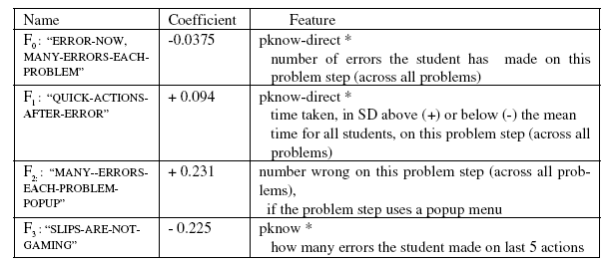
You can study the model
Baker, Corbett, & Koedinger’s (2004) model of gaming the system/ systematic guessing

Slide 35
You can study the context of the model’s predictions
 | HARDEST SKILLS (pknow< 20%) | EASIEST SKILLS (pknow> 90%)
GAMED HURT | 12% of the time | 2% of the time
GAMED NOT HURT | 2% of the time | 4% of the time

Slide 36
Boosting

Slide 37
Boosting
Let’s say that you have 300 labeled actions randomly sampled from 600,000 overall actions
Not a terribly unusual case, in these days of massive data sets, like those in the PSLC DataShop
You can train the model on the 300, cross-validate it, and then apply it to all 600,000
And then analyze the model across all actions
Makes it possible to study larger-scale problems than a human could do without computer assistance
Especially nice if you have some unlabeled data set with nice properties
For example, additional data such as questionnaire data (cf. Baker, 2007; Baker, Walonoski, Heffernan, Roll, Corbett, & Koedinger, 2008

Slide 38
However…
To do this and trust the result,
You should validate that the model can transfer

Slide 39
Validate the Transfer
You should make sure your model is valid in the new context (cf. Roll et al, 2005; Baker et al, 2006)
Depending on the type of model, and what features go into it, your model may or may not be valid for data taken
From a different system
In a different context of use
With a different population

Slide 40
Validate the Transfer
For example
Will an off-task detector trained in schools work in dorm rooms?

Slide 41
Validate the Transfer
For example
Will a gaming detector trained in a tutor where {gaming=systematic guessing, hint abuse}
Work in a tutor where {gaming=point cartels}

Slide 42
Maybe…

Slide 43
Baker, Corbett, Koedinger, & Roll (2006)
We tested whether
A gaming detector trained in a tutor unit where {gaming=systematic guessing, hint abuse}
Would work in a different tutor unit where {gaming=systematic guessing, hint abuse}

Slide 44
Scheme
Train on data from three lessons, test on a fourth lesson
For all possible combinations of 4 lessons (4 combinations)

Slide 45
Transfer lesson .vs. Training lessons
Ability to distinguish students who game from non-gaming students
Overall performance in training lessons: A’ = 0.85
Overall performance in test lessons: A’ = 0.80
Difference is NOT significant, Z=1.17, p=0.24 (using Strube’s Adjusted Z)

Slide 46
So transfer is possible…
Of course 4 successes over 4 lessons from the same tutor isn’t enough to conclude that any model trained on 3 lessons will transfer to any new lesson

Slide 47
What we can say is…

Slide 48
If…
If we posit that these four cases are “successful transfer”, and assume they were randomly sampled from lessons in the middle school tutor…

Slide 49
Maximum Likelihood Estimation
Notes:
Unlikely to be less than 50% of models IN THIS CURRICULUM
Most likely around 83%
Still not really good enough

Slide 50
Studying a Construct Across Contexts
Using this detector (Baker, 2007)

Slide 51
Research Question
Do students game the system because of state or trait factors?
If trait factors are the main explanation, differences between students will explain much of the variance in gaming
If state factors are the main explanation, differences between lessons could account for many (but not all) state factors, and explain much of the variance in gaming
So: is the student or the lesson a better predictor of gaming?

Slide 52
Application of Detector
After validating its transfer
We applied the gaming detector across 35 lessons, used by 240 students, from a single Cognitive Tutor
Giving us, for each student in each lesson, a gaming frequency

Slide 53
Model
Linear Regression models
Gaming frequency = Lesson + α₀
Gaming frequency = Student + α₀

Slide 54
Model
Categorical variables transformed to a set of binaries
i.e. Lesson = Scatterplot becomes
3DGeometry = 0
Percents = 0
Probability = 0
Scatterplot = 1
Boxplot = 0
Etc…

Slide 55
Metrics

Slide 56
r²
The correlation, squared
The proportion of variability in the data set that is accounted for by a statistical model

Slide 57
r²
The correlation, squared
The proportion of variability in the data set that is accounted for by a statistical model

Slide 58
r²
However, a limitation
The more variables you have, the more variance you should be expected to predict, just by chance

Slide 59
r²
We should expect
240 students
To predict gaming better than
35 lessons
Just by overfitting

Slide 60
So what can we do?

Slide 61
BiC
Bayesian Information Criterion (Raftery, 1995)
Makes trade-off between goodness of fit and flexibility of fit (number of parameters)

Slide 62
Predictors

Slide 63
The Lesson
Gaming frequency = Lesson + α₀
35 parameters
r² = 0.55
BiC’ = -2370
Model is significantly better than chance would predict given model size & data set size

Slide 64
The Student
Gaming frequency = Student + α₀
240 parameters
r² = 0.16
BiC’ = 1382
Model is worse than chance would predict given model size & data set size!

Slide 65
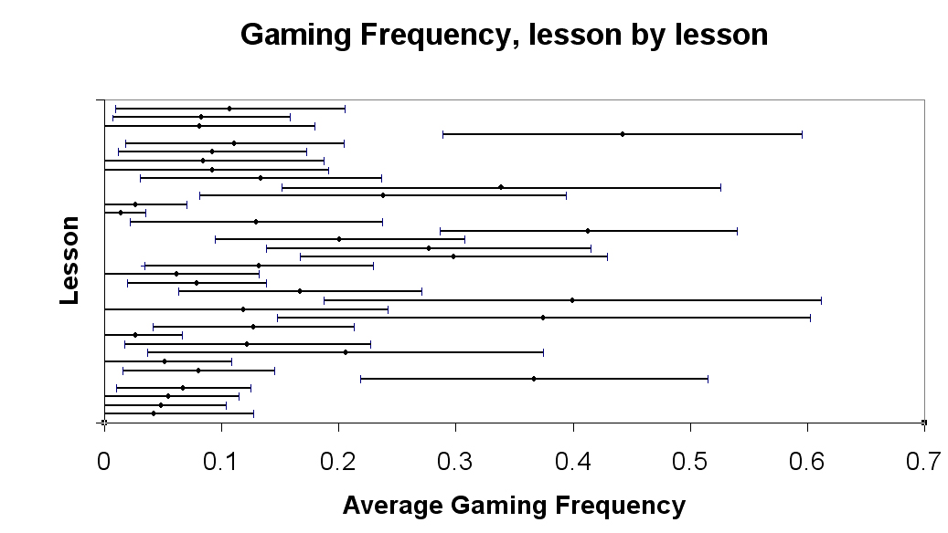
Standard deviation bars, not standard error bars

Slide 66
In this talk…
Discovery with Models to
Find outliers of interest by finding out where the model makes extreme predictions
Inspect the model to learn what factors are involved in predicting the construct
Find out the construct’s relationship to other constructs of interest, by studying its correlations/associations/causal relationships with data/models on the other constructs
Study the construct across contexts or students, by applying the model within data from those contexts or students

Slide 67
Necessarily…
Only a few examples given in this talk

Slide 68
An area of increasing importance within EDM…

